Slide 1
Twinning project ENEA – ENforcing Environmental Acquis
6th Steering Committee
César Seoánez
Skopje, 21st of July, 2016

Slide 2
OUTLINE
6th quarter assessment (12 April – 11 July 2016)
Quarterly Report 6
Programme until end of implementation (12 July – 11 August 2016)
Operative Side Letter 7
Outputs delivered to Steering Committee

Slide 3
Coordination
6th QUARTER:
Meetings: multiple, within missions, with stakeholders, specially inspectors
Several meetings with Inspection Council & activities with & for them
Coordination with TA project supporting local level
Participation in Steering Committees & closure event
Participation of its Team Leader in training; discussion about networking
Coordination with Twinning IED
Info about outputs, incl. English translation of updated draft Law for Ins. on Env. shared
Participation in Steering Committee, providing suggestions on project extension
Info on QR5 sent to DG NEAR & DG Environment

Slide 4
Communication
6th QUARTER:
Website: www.sei.gov.mk
All supporting materials, incl. Waste Watch, Guidance on Sampling, updated leaflet
News in Macedonian media:
TV channel Nova on the 10/05/2016 (training in Gevgelija)
Macedonian TV and written media on the 31/05/2016 (training in Prilep)
Second youtube video by FIIAPP including interviews to beneficiaries
Drafting of article for American Chamber of Commerce in Macedonia
Printing of updated leaflet, Waste Watch, insp. manual & factsheets
Press conference in Economic Chamber, 11/07/2016
Info event about EU funding possibilities for Inspectorates, 07/07/2016

Slide 5
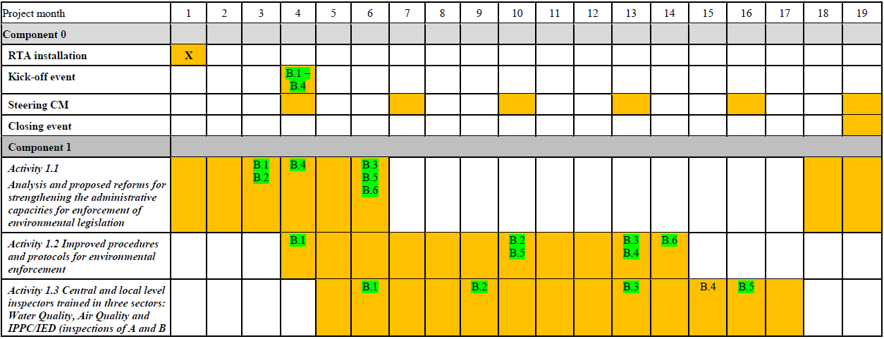
Progress vs. Work Plan
6th QUARTER:

Slide 6
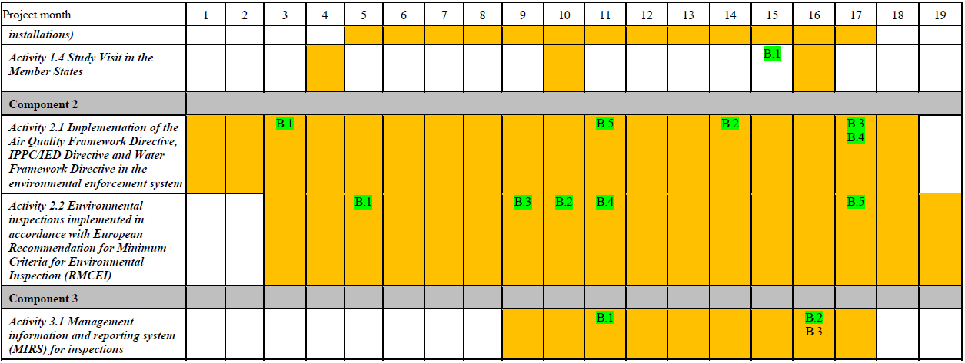
Progress vs. Work Plan
6th QUARTER:
Good

Slide 7
Activities
6th QUARTER:
April (starting 12th )
Activity 1.3, mission 7: 3 one-day trainings on comm. skills & team building
Activity 2.2, mission 6: training based on inspection to pilot installation (region 3)
Steering Committee 5: 22nd April
Activity 3.1, mission 3: training on use of IRAM software

Slide 8
Activities
6th QUARTER:
May
Activity 1.3, mission 8: 3 one-day trainings on comm. skills & team building
Activity 2.2, mission 7: training based on inspection to pilot installation (region 2)
Activity 3.1, mission 3: further work on BPMS
Updated project’s brochure
Letter from SEA supporting draft Law and recommending adoption

Slide 9
Activities
6th QUARTER:
June
Activity 2.2, mission 8: training based on inspection to pilot installation (region 4)
Activity 2.1, mission 9: first training on sampling & monitoring
Activity 2.1, mission 10: second training on sampling & monitoring
July (until 11th )
Info session on EU funding possibilities for Inspectorates
Activity 2.1, mission 4.b: Meeting between Dutch & Macedonian Inspection Councils
Press conference in Economic Chamber

Slide 10
Activities
6th QUARTER:
Main outputs
SEI - Twinning website & updated brochure
Waste Watch booklet for control of waste shipments
Small guidance for sampling & control of self-monitoring reports
MK translation of Chapter 5 (BAT Conclusions) BREF for pig & poultry farms
Updated assessment and recom. for sustainability & next upgrades of BPMS
ALB translation of inspection manual
MK translation of Chapter 5 (BATs) BREF for management of tailings and waste-rock in mining
Trainings on skills, sampling & monitoring, and pilot inspections

Slide 11
Activities
6th QUARTER:
Other outputs
Info session for Inspectorates
Press conference in Economic Chamber
Article in magazine of American Chamber of Commerce in Macedonia

Slide 12
Participation BC experts
6th QUARTER:
295 BC participants in meetings/trainings held in missions
High participation, with high number from local level

Slide 13
Expenditures
6th QUARTER:
As planned
Savings in flight tickets
In 6th quarter ~ 15.2 % of activities’ budget

Slide 14
QUARTERLY REPORT
Draft Law → prepare to send to Government in August
Inspection Council should address Twinning docs sent,
to align to EU best practices (review of LoIS starts Sept.)
Overload in planning & reporting, evaluation of inspectors with financial penalties...
Managers in SEI, MoEPP, CFCD, DEU & SEA should continue pushing for a change in Law for Insp. Supervision
Create Network of Environmental Inspectors
Tool to absorb, update and promote the use of outputs of project
Wrap-up: contact list, DVD copies with all materials...
Inventory of installations: collect & compile data

Slide 15
PROGRAMME UNTIL END
July (starting 12th)
Activity 1.3, mission 9: four 1-day workshops to close training programme
Activity 1.1, mission 6: follow-up projects
Closure event: 20th July
Steering Committee 6: 21st July
Activity 3.1, mission 4: final mission BPMS
August(until 11th)
Work to set up basis for Network of Environmental Inspectors
Closure of project, final reporting

Slide 16
OPERATIVE SIDE LETTER 7
Builds upon side letter 12
Explicit approval of OSL is very welcome

Slide 17
COMMENTS TO OUTPUTS DELIVERED TO ST.C.?
1.2.6 – Waste Watch booklet
1.2.12 – final version of inspection manual in ALB
3.1.3.b – SEI’s BPMS updated assessment & proposals for next steps
2.1.9 – 2.1.10: Brief guidance on sampling & control of self-monitoring reports
2.1.4.b – Report on meeting between Dutch & Macedonian Inspection Councils

Slide 18
Thank you very much !
Благодарам многу!
www.sei.gov.mk
blinkov_d@yahoo.com
inspection.cs@gmail.com

