Slide 1
Twinning project ENEA – ENforcing Environmental Acquis
3rd Steering Committee
César Seoánez
Skopje, 30th of October, 2015

Slide 2
OUTLINE
3rd quarter assessment (12 July – 11 October 2015)
Quarterly Report 3
Programme for next 6 months (12 October 2015 – 11 April 2016)
Operative Side Letter 4
Outputs delivered to Steering Committee
Addendum 2

Slide 3
Coordination
3rd QUARTER:
Meetings: multiple, within missions, with stakeholders, except Inspection Council
Coordination with TA project supporting local level
Participation in meeting organized by TA on proposals to improve permitting system
Meeting to exchange ideas & coordinate training programmes
Sharing relevant information gathered
Info exchange with:
Twinning IED: meeting with RTA & RTA Counterpart after start of project
Twinning Air Quality: participation in their Kick-off

Slide 4
Communication
3rd QUARTER:
Website: www.sei.gov.mk
Study tour Portugal-Extremadura: meeting Inspector General, and
press release FIIAPP
Filming of promotional video (to be published online)
Visibility-related info shared with DEU staff in charge of visibility

Slide 5
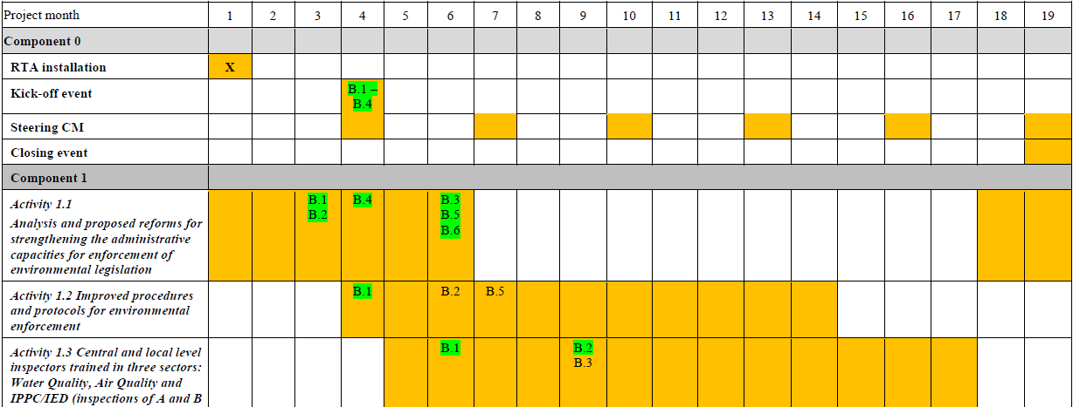
Progress vs. Work Plan
3rd QUARTER:

Slide 6
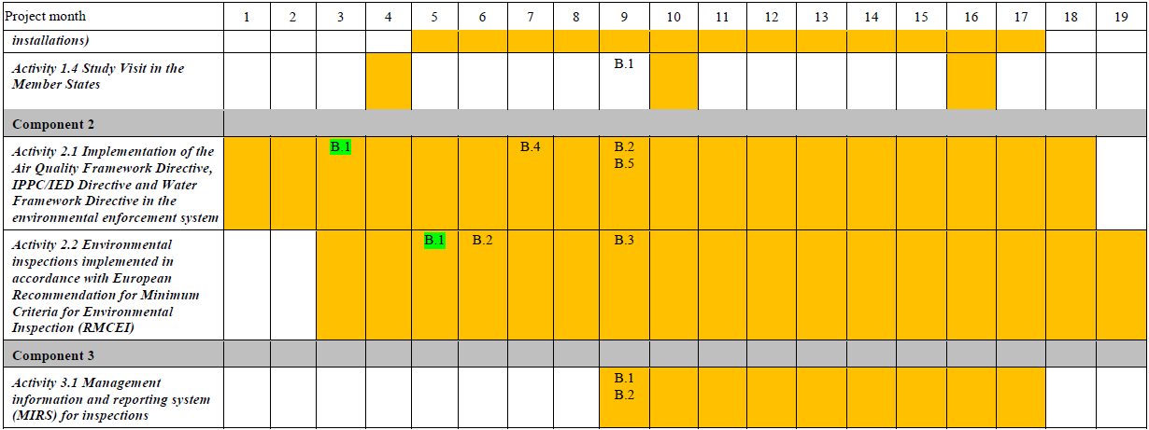
Progress vs. Work Plan
3rd QUARTER:
Good, only delay in mission to discuss new Law (act. 2.1)
(to be implemented in Nov)

Slide 7
Activities
3rd QUARTER:
July (starting 12th )
Quarterly Report 2, Operative Side Letter 3
Activity 1.2, mission 9: guidance for BAT inspection in IPPC installations
Activity 2.1, mission 5: risk matrix-based approach to plan inspections
Steering Committe 2: 30th July
August
Start of Activity 1.3, mission 2: elaboration of Twinning’s training programme
Translation of outputs: proposals for improvement, inspection manual

Slide 8
Activities
3rd QUARTER:
September
Activity 3.1, mission 1: assessment of SEI’s BPMS → with follow-up in Nov.
Activity 2.2, mission 4: training curricula for RMCEI implementation
Activity 1.4, mission 2: study visit to Portugal & Extremadura (Spain)
Addendum 1 endorsed
On-the-spot monitoring visit
October (ending 11th )
Recording of promotional video
Work & discussion of draft Law (SEI & MoEPP legal experts)

Slide 9
Activities
3rd QUARTER:
Main outputs
SEI - Twinning website
Adaptation of IRAM risk assessment tool to Macedonian situation
Twinning training programme
Long-term training curricula & capacity building proposals
Almost completed draft new Law for Inspection on Environment

Slide 10
Activities
3rd QUARTER:
Other outputs
Draft BAT inspection guidance in IPPC installations
First assessment of SEI’s BPMS and recommendations for next steps
Translation into Macedonian of recommendations for improvement
Visibility-related: press release & video filming

Slide 11
Participation BC experts
3rd QUARTER:
37 BC participants in meetings held in missions
A lot of drafting (to continue until February 2016)

Slide 12
Expenditures
3rd QUARTER:
A bit less planned, due to delay in mission to discuss draft Law
Savings in flight tickets
In 3rd quarter ~ 12 % of activities’ budget

Slide 13
QUARTERLY REPORT
Project’s progress good, but external challenging factors
Role of Inspection Council & Law on Inspection Supervision
Independence of inspectors at local level
EU best practice “collides” (see examples in document with
proposals for improvement):
Risk based planning, reporting & evaluation of inspectors
Less inspections, more extensive
Final target: from quantity to quality and real results
Inspection Council activity should be monitored by EC

Slide 14
QUARTERLY REPORT
Central planning & control of inspectors → new Law
Penalise mayors not fulfilling their duties → done!
Review & implement recommendations for improvement
BPMS & database coordination → follow recommendations
Addendum 2: training programme → needs endorsement

Slide 15
PROGRAMME NEXT 6 MONTHS
October (starting 12th )
Activity 1.2, mission 7: factsheets for industrial sectors
Activity 1.2, mission 5: check lists for some waste streams
RTA Training in Brussels, 15-16 October
Activity 1.2, mission 4: last mission for general inspection manual
Activity 1.3, mission 3: preparation of training materials
Steering Committe 3

Slide 16
PROGRAMME NEXT 6 MONTHS
November
Activity 3.1, follow-up of mission 1: BPMS assessment & 1st recommendations
Activity 2.1, mission 4: discuss 1st draft of Law for Inspection on Environment
Activity 2.1, mission 6: other supporting materials & training on planning (IRAM)
Activity 1.2, mission 10: 2nd mission to finalise IPPC/BAT guidelines
December
Activity 2.2, mission 5: 4 one-day workshops on inspection cycle
Activity 1.2, mission 8: 2nd mission to finalise factsheets for industrial sectors

Slide 17
PROGRAMME NEXT 6 MONTHS
January
Activity 1.2, start of mission 6: 2nd mission for check lists waste streams
Activity 2.1, start of mission 8: control & remediation of old polluted sites
Activity 1.2, mission 11: 1st mission leaflet operators & communication strategy
February
Activity 2.1, mission 7: other supporting documents
Steering Committee 4: 9th February
Activity 3.1, mission 2: Workshop about BPMS in EU (to be defined in Nov)
Activity 1.2, mission 8: 2nd mission to finalise leaflet operators & comm strategy

Slide 18
PROGRAMME NEXT 6 MONTHS
March
Activity 1.3, mission 4: 2 two-days trainings on industrial processes (regions 1 & 2)
Activity 1.3, mission 5: 2 two-days trainings on industrial processes (regions 3 & 4)
Activity 1.3, mission 6: training on integrated environmental inspections (region 1)
April (until 11th)
Activity 1.4, mission 3: study visit to The Netherlands

Slide 19
OPERATIVE SIDE LETTER 4
Side letter 9: mission 2.2.5 starting 30th November
Explicit approval of OSL is very welcome

Slide 20
COMMENTS TO OUTPUTS DELIVERED TO ST.C.?
2.2.3 – Ensuring compliance with RMCEI, IED & TFS
2.1.5 – Risk-based planning of environmental inspections
1.1.5 – Proposals for improvement of inspection system (MK version)
1.3.2 – Training programme
2.2.4 – Profile and long-term training curricula for environmental inspectors

Slide 21
ADDENDUM 2
Motivation
Training programme & related benchmarks require improvement
Cumulative budget modifications >25%
Proposal
Meeting 6th November with CFCD, DEU, MoEPP IPA Unit to discuss it
Send officially for CFCD’s assessment latest 17th November

Slide 22
Thank you very much !
Благодарам многу!
www.sei.gov.mk
blinkov_d@yahoo.com
inspection.cs@gmail.com

