Slide 1
Twinning project ENEA – ENforcing Environmental Acquis
1st Steering Committee
César Seoánez
Skopje, 29th of April, 2015

Slide 2
OUTLINE
1st quarter assessment (12 January – 11 April 2015)
Quarterly Report 1
Programme for next 6 months (12 April – 11 October 2015)
Operative Side Letter 2
Addendum 1
Inception Report

Slide 3
Coordination
1st QUARTER:
Initial meetings: SEI, MoEPP, ZELS, MoLSG, local inspectors, industries, CFCD, DEU
Coordination with TA project supporting local level
Info exchange with:
TA Project Water Management
Twinning IED (not yet started)
Twinning Air Quality (not yet started)

Slide 4
Communication
1st QUARTER:
Website: www.sei.gov.mk
Other visibility materials: leaflet, notebooks, folder, pen, mug, banner
Questionnaire
Bitola University
Training on Twinning + monitoring visit

Slide 5
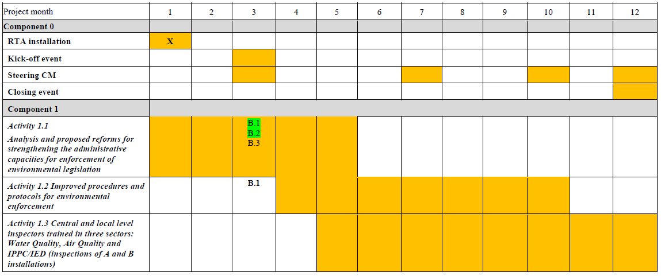
Progress vs. Work Plan
1st QUARTER:

Slide 6
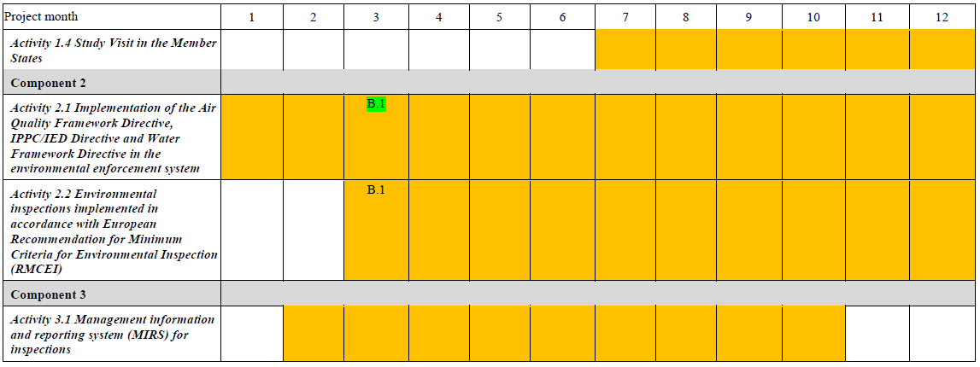
Progress vs. Work Plan
1st QUARTER:
Good (delay in Kick-off requested by BC)

Slide 7
Activities
1st QUARTER:
January (starting 12th )
Arrival RTA, selection of assistants
Initial meetings with MoEPP, ZELS, CFCD, DEU
Discussion with SEI key staff about their needs & definition of work plan
February
Further meetings with inspectors & other stakeholders
Website
1.1, mission 1 (institutional assessment)

Slide 8
Activities
1st QUARTER:
March
2.1, mission 1: legal assessment
2.2, mission 1: review related to inspection planning & reporting
1.1, mission 2 (institutional assessment)
2.1, mission 2: legal assessment & discussion of new Law for Insp. on Env.
Delivery of Addendum 1

Slide 9
Activities
1st QUARTER:
April (ending 11th )
Preparation Kick-off
Preparation visibility materials
Preparation missions April – May: Side Letter 3
Start drafting Inception Report
Main outputs
SEI website & project leaflet
Institutional assessment
Legal assessment
Inception Report – Addendum 1

Slide 10
Activities
1st QUARTER:
Other outputs
Translation into English of Law on Inspection Supervision
Translation into English of parts of existing legislation relevant for env. inspection

Slide 11
Participation BC experts
1st QUARTER:
52 BC participants in meetings held in missions
Excluding initial meetings held in January - February

Slide 12
Expenditures
1st QUARTER:
As planned
Savings in flight tickets
In 1st quarter ~ 6.87 % of activities’ budget

Slide 13
QUARTERLY REPORT
Project challenges addressed in Addendum 1
Essential to endorse as fast as possible Addendum 1

Slide 14
PROGRAMME NEXT 6 MONTHS
April (starting 12th )
Activity 1.1, mission 3: workshops to discuss with stakeholders
Activity 1.2, mission 1: analysis of existing docs, planning of docs to deliver
Quarterly Report 1, Operative Side Letter 2, Inception Report
Kick-off event (act. 0.1)
Steering Committe 1
May
Activity 1.1, mission 4: Drafting proposals for institutional improvement
Activity 1.2, mission 2: Start drafting inspection manual

Slide 15
PROGRAMME NEXT 6 MONTHS
May
Activity 2.2, mission 2: Updates to legislation related to planning & reporting
Activity 1.4, mission 1: Study visit to Galicia (Spain)
June
Activity 2.1, mission 3: Support in elaboration of new Law for Insp. on Env.
Activity 2.2, mission 3: Adoption of RMCEI
Activity 1.1, mission 5: Final version of proposals for institutional improvement
Activity 1.3, mission 1: Training Needs Assessment

Slide 16
PROGRAMME NEXT 6 MONTHS
July
Activity 1.2, mission 3: 2nd mission to draft manual inspections
Activity 1.2, mission 9: 1st mission to draft BAT guidance
Quarterly Report 2, Operative Side Letter 3
Activity 1.2, mission 4: 3rd (and last) mission to draft manual inspections
Activity 2.1, mission 5: risk matrix-based approach to plan inspections
Steering Committe 2: 30th July
August
Activity 1: Enjoy life
Activity 2: Rest a bit

Slide 17
PROGRAMME NEXT 6 MONTHS
September
Activity 1.3, mission 2: training programme & start drafting materials
Activity 1.2, mission 5: 1st mission to draft check lists waste
Activity 3.1, mission 1: Analysis of BPMS
Activity 2.2, mission 4: training curricula for RMCEI implementation
Activity 2.1, mission 4: finalise proposals for new Law for Insp. on Env.
Activity 1.4, mission 2: study tour to Portugal
October (until 11th )
No mission

Slide 18
OPERATIVE SIDE LETTER 2
If no objections to contents, time for approval?
Slight change: delete from mission 1.2.7 names of experts

Slide 19
ADDENDUM 1: Changes since version 15th April
Main text: Cumulative amount (due to corrigendum SL2)
Annex 2 (original & amended text):
Rob Kramers is assigned as Component Leader of Component 2
Dimitris Tsotsos is included in activities 1.2 and 1.3
B.1.1.7 : Draft proposals for structure and contents, not Twinning Fiches
Annex 3 (explanatory note):
Rob Kramers is assigned as Component Leader of Component 2
Dimitris Tsotsos is included in activities 1.2 and 1.3
Correction of amounts stated for translation/interpretation
B.1.1.7 : Draft proposals for structure and contents, not Twinning Fiches

Slide 20
INCEPTION REPORT
Agreed by Partners
In line with Addendum 1
Calendar in A3
Highlights:
Act. 1.1: mission 1.1.6, proposals for new projects
Act. 1.2: inspection manual integrating IPPC/BAT guidelines + check lists
Act. 1.2: industrial activities → factsheets + list of issues to inspect
Act. 1.2: will take into account materials from previous Twinning on Waste

Slide 21
INCEPTION REPORT
Highlights:
Act. 1.3: train the trainer
Act. 2.2: RMCEI + IED art. 23
Act. 3.1: BPMS & IRAM

Slide 22
Thank you very much !
Благодарам многу!
www.sei.org.mk
blinkov_d@yahoo.com
inspection.cs@gmail.com

